Slide 1
Using R for Practical Statistical Analysis - Statistical Inference
November, 2016
Frank Hasbani (PMP, CSM), Mark Jack (PhD),
Oleg Krivosheev (PhD)
Anova Analytics LLC
Anovaanalytics.com

Slide 2
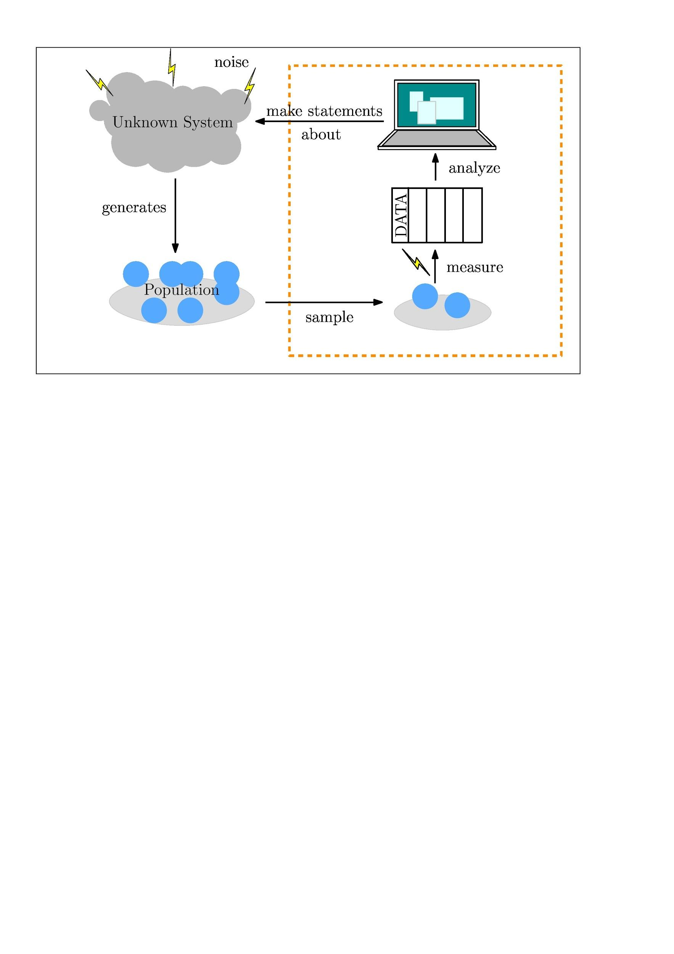
What is Statistical Inference

Slide 3
What is Statistical Inference
Statistical inference is used to make general statements about a population, when we only have access to information about a (hopefully representative!) subset of population, usually chosen through some form of sampling.
Basic statistical inference consists of the following steps:
Choosing a hypothesis.
Selecting a statistical model of the process that could be used to analyze the sample.
Deducing propositions from the model.

Slide 4
What Lets Us Do This?
(The Philosophy Behind the Analysis)
Two broad categories that get discussed a lot are:
Frequency Inference
&
Bayesian Inference
Data scientists tend to fall within different shades of gray of these and various other schools of inference.

Slide 5
Frequency Inference
Frequency interpretation of probability: The probability of a given outcome can be interpreted as the proportion of times that the outcome occurs in an infinite set of identical, independent repetitions of the experiment.
Frequency inference: Given a large enough sample size, the number of times that a particular outcome occurs is proportional to its probability. Therefore, we can make meaningful statements about the system that generated this sample.
Frequency inference is the basis for hypothesis testing.
A good approach when we want to know e.g. “Is this a fair coin?”

Slide 6
Bayesian Inference
Bayesian interpretation of probability: Probability is interpreted as a state of belief about unknown quantities in a system.
Bayesian inference: is the probability calculus of beliefs, given that beliefs follow certain rules.
Treats model parameters as random variables, and assigns probability distributions to them. As more data is collected, the probabilities are updated.
A good approach when we want to know e.g. “How confident am I that this coin lands “heads” with probability p?”

Slide 7
Let’s jump right in…
… with a frequentist interpretation, and start with some basic hypothesis testing!

Slide 8
Statistical hypothesis testing
Can be used to compare two statistical data sets, or to compare a data set obtained by sampling with synthetic data from an idealized model.
Hypothesis testing allows us to distinguish--in a statistically meaningful way, between the null hypothesis and an alternative that we propose to test.
Eg., We want to test whether singing to a Lima bean makes it grow faster.
Null hypothesis: the mean heights of bean sprouts after 10 days are equal for beans that have been sung to, and a non-musical control group.
Alternate hypothesis: The mean height of the beans in the sung-to group is larger than that of the control group.

Slide 9
Real world applications of hypothesis testing
Examples:
Testing whether more men than women suffer from nightmares.
Establishing authorship of documents.
Evaluating the effect of the full moon on behavior.
Determining the range at which a bat can detect an insect by echo.
Deciding whether hospital carpeting results in more infections.
Selecting the best means to stop smoking.
Checking whether bumper stickers reflect car owner behavior.
Testing the claims of handwriting analysts.

Slide 10
Useful Aside: Central Limit Theorem
Given a large enough set of observations X₁, X₂, …, X_{N}, the mean
μ_{N} = (X₁ + X₂ + … + X_{N})/N
has an approximately Gaussian distribution, with variance
σ²_{N} = (sample variance)/N
N.B. But there are counterexamples – Cauchy!

Slide 11
Example: Coin Flip
Say we flip a coin 100 times and end up with the following results:
The coin lands HEADS 66 times
The coin lands TAILS 34 times
Can we conclude that the coin is biased?
Here, the null hypothesis is that we have a fair coin:
p(HEADS) = p(TAILS) = ½
And the alternate hypothesis is that the coin is not fair.

Slide 12
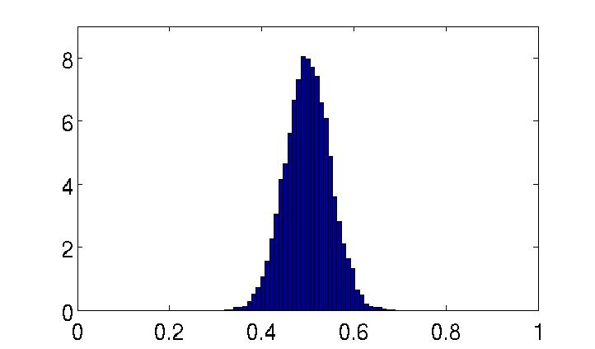
Example: Coin Flip
Given a known fair coin, we run 10,000 experiments of 100 coin flips. We record HEADS as 0 and TAILS as 1, and find the mean value for each experiment:
Experiment 1:
44 HEADS, 56 TAILS - mean = 0.56
Experiment 2:
62 HEADS, 38 TAILS - mean = 0.38
Experiment 3:
56 HEADS, 44 TAILS - mean = 0.44
Experiment 4:
45 HEADS, 55 TAILS - mean = 0.55

Slide 13
Example: Coin Flip
Given a known fair coin, we run 10,000 experiments of 100 coin flips. We record HEADS as 0 and TAILS as 1, and find the mean value for each experiment:
Experiment 1:
44 HEADS, 56 TAILS - mean = 0.56
Experiment 2:
62 HEADS, 38 TAILS - mean = 0.38
Experiment 3:
56 HEADS, 44 TAILS - mean = 0.44
Experiment 4:
45 HEADS, 55 TAILS - mean = 0.55
Our observation (mean = 0.34) does not seem so likely if the coin is fair!

Slide 14
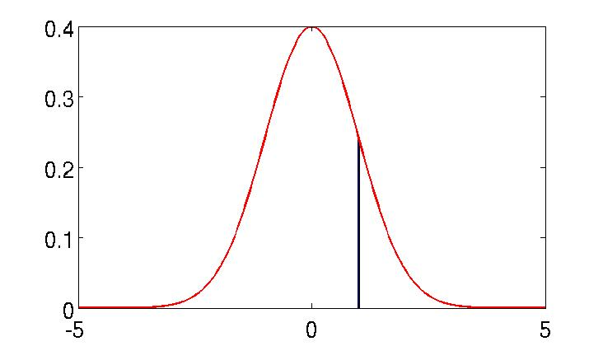
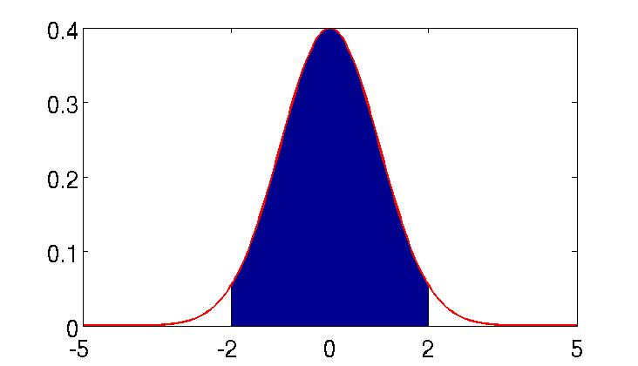
Confidence Interval and p-value
Standard Normal Distribution
P(x ∈ (1-ε, 1+ε))

Slide 15
Confidence Interval and p-value
Standard Normal Distribution
P(x ∈ (-1.96, 1.96)) ≈ 0.95
An observation outside the shaded interval has an approx. 5% chance of occurring if the underlying distribution is normal.

Slide 16
Confidence Interval and p-value
Testing the null hypothesis using confidence interval:
select a desired confidence level c (usually 5%)
under the null hypothesis, what is the interval that contains the outcome of the experiment with probability (1-c)% (95% for c = 5%)?
reject the null hypothesis if the observed value lies outside the confidence interval.
Testing the null hypothesis using p-value:
given an observed value, what is the probability (under the null hypothesis) that an outcome will have a value at least as extreme as the observed?
reject the null hypothesis if the above probability is smaller than some threshold (usually 5%).

Slide 17
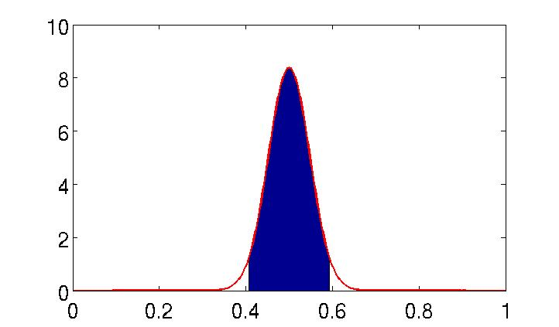
Example: Coin Flip – Confidence Intervals
Null hypothesis: probability density function of the coin flip is Gaussian with mean 0.5 and
standard deviation = (sample standard deviation)/10 = 0.00476
observed outcome:
0.34
confidence interval:
(0.4067, 0.5933)
… so, we reject the null hypothesis

Slide 18
Example: Coin Flip – p-value
Null hypothesis: probability density function of the coin flip is Gaussian with mean 0.5 and
standard deviation = (sample standard deviation)/10 = 0.0476
P(outcome<0.34 or >0.84) = 0.078% < 5%
observed outcome: 0.34
… so, we reject the null hypothesis

Slide 19
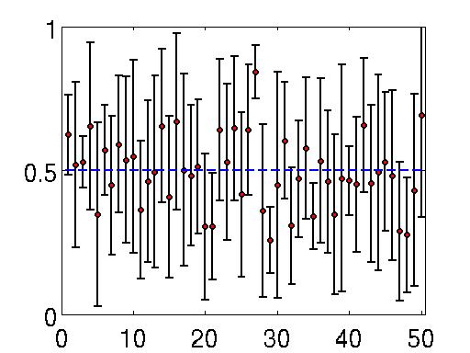
Sample Size
Note: CLT only holds if the sample size is large enough.
E.g. consider an experiment where we flip a coin only 5 times:
How often does the confidence interval not contain the true mean?
(it should happen 5% of the time)

Slide 20
Sample Size
Note: CLT only holds if the sample size is large enough.
E.g. consider an experiment where we flip a coin only 5 times:
How often does the confidence interval not contain the true mean?
(it should happen 5% of the time)
Depends on the sample size...

Slide 21
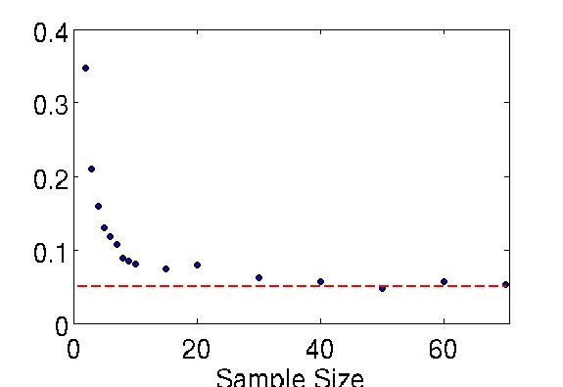
Sample Size
Note: CLT only holds if the sample size is large enough.
E.g. consider an experiment where we flip a coin only 5 times:
We perform N flips of a fair coin 5000 times, and compute the fraction of cases where using the Gaussian 95% confidence interval makes us falsely reject the null hypothesis that the coin is fair.
It happens often for small sample sizes!

Slide 22
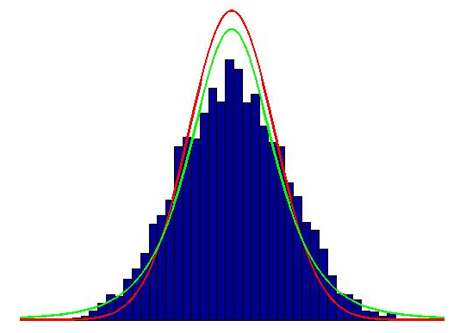
Solution: Try a Different Distribution
When the sample size is small, the CLT does not hold, and we can’t reasonably assume that the mean has a Gaussian distribution.
A better approximation may be a more heavy-tailed distribution, e.g. the Student’s t-distribution (named after William Sealy Gosset’s pseudonym):
Red: Gaussian fit (with variance determined for a single run of the experiment)
Green: Student’s t-distribution (for the same experimental run)
E.g. coin flip:
Distribution of means for 5 coin flips, repeated 5000 times:

Slide 23
Comparing Two Populations
Say I have two coins. I’ve been fiddling with the second coin, filing the edges and so on, in an attempt to see whether I can increase the probability of getting “Heads”. I want to test whether all this work paid off.
Say p1 is the probability of rolling heads with the unmodified coin, and p2 is the probability of rolling heads with the second, modified coin.
Null hypothesis: There is no difference between p1 and p2.
Alternative hypothesis: The probability p2 is higher than p1.

Slide 24
Comparing Two Populations
First, we collect some observations…
Coin 1:
T H T T T T T H T H T H H H H T T H T H … 11 Tails, 9 Heads
Coin 2:
H H T T H H H H T T H H H H H H T H H H … 5 Tails, 15 Heads
The means we get from data are p1 = 0.45 and p2 = 0.75. But, is the difference statistically significant?

Slide 25
Two-Sample T-Test
Assuming that both populations have equal variance, and using the same sample size n (here, n = 20), we can use a 2-sample t-test with
t = (mean1 - mean2)/√(2(var1+var2)/n)
Coin flip example:
Null hypothesis is rejected with p-value 2.71%.

Slide 26
Another Way to Go: Analysis of Variance (ANOVA)
A collection of statistical models used to analyze the differences among group means and their associated procedures (such as "variation" among and between groups), developed by Ronald Fisher.
The observed variance in a particular variable is partitioned into components attributable to different sources of variation.
It provides a statistical test of whether or not the means of several groups are equal, and therefore generalizes the t-test to more than 2 groups.
Useful for comparing (testing) three or more means (groups or variables) for statistical significance.
Conceptually similar to multiple two-sample t-tests, but is less conservative (results in less type I error) and is therefore suited to a wide range of practical problems.

Slide 27
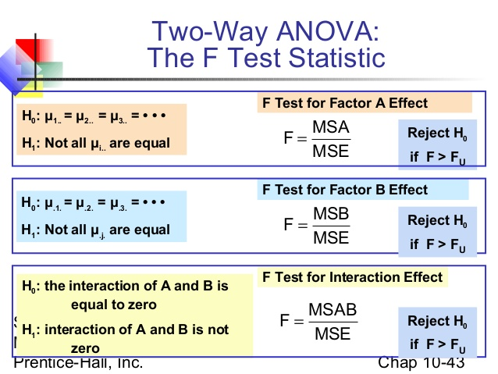
Two-way analysis of variance with ANOVA
ANOVA generalizes to the study of the effects of multiple factors. When the experiment includes observations at all combinations of levels of each factor, it is termed factorial.
Factorial experiments are more efficient than a series of single factor experiments and the efficiency grows as the number of factors increases. Consequently, factorial designs are heavily used.

Slide 28
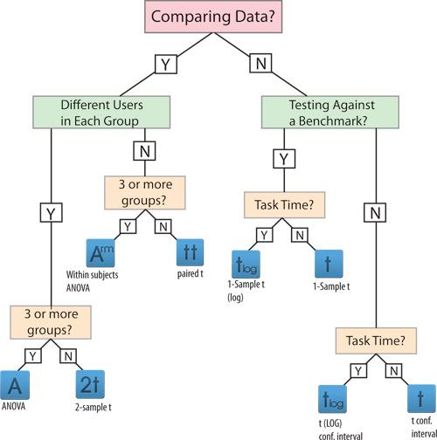
T-Test or ANOVA?

Slide 29
Recap: The Process of Hypothesis Testing
State the relevant null and alternative hypotheses, H₀ and H₁.
Consider the statistical assumptions being made about the sample in doing the test.
Decide which test is appropriate and state the relevant test statistic T.
Derive the distribution of the test statistic under the null hypothesis from the assumptions.
Select a significance level (α), a probability threshold. Common values are 5% and 1%.
Partition the values of T into the so-called critical region and those for which it is not.
Compute from the observations the observed value t_{obs} of the test statistic T.
Decide to either reject the null hypothesis H₀ in favor of the alternative H₁ or do not reject it.

Slide 30
… While keeping in the back of your mind:
The process of distinguishing between the null hypothesis and the alternative hypothesis is aided by identifying two conceptual types of errors (type 1 & type 2), and by specifying parametric limits on e.g. how much type 1 error will be permitted.
Type 1 Error: Incorrect rejection of the null hypothesis, or “false positive”.
Type 2 Error: Accepting the null hypothesis when it is, in fact, not true, or “false negative”.
Depending on your application, you may worry about one type of error much more than the other.
Power of hypothesis test: probability of correctly rejecting the null hypothesis given alternative hypothesis is true.
Gives a measure of type 1 and type 2 error rates we can expect.

Slide 31
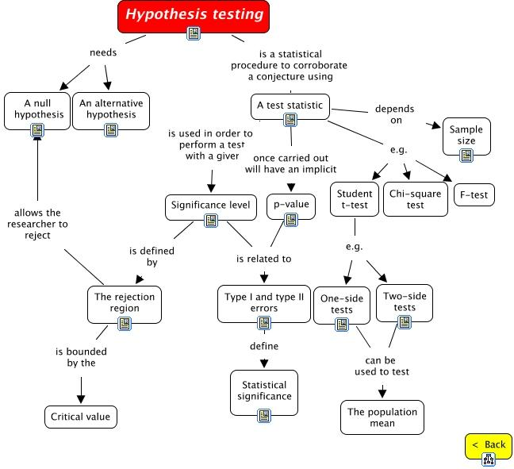

Slide 32
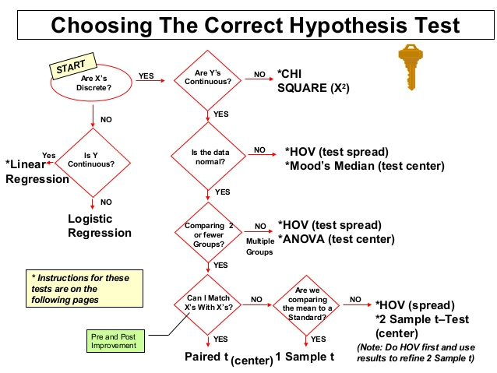

Slide 33
Common Pitfalls of Hypothesis Testing
Test statistics effect
P-value effect
Small size effect
Large size effect
Multiple Comparisons
…

Slide 34
Quick Note
In the coin flip example, we know that the samples are generated by flipping a coin that lands heads with some probability p, so we know that the outcome of the experiment will be a set of values with a binomial distribution…
… But things are not always that easy! Many times, we are presented with data without knowing a priori what mechanism was used to generate it.

Slide 35



Model Selection
"The majority of the problems in statistical inference can be considered to be problems related to statistical modeling" (from Konishi & Kitagawa)
"How [the] translation from subject-matter problem to statistical model is done is often the most critical part of an analysis" (Sir David Cox)

Slide 36
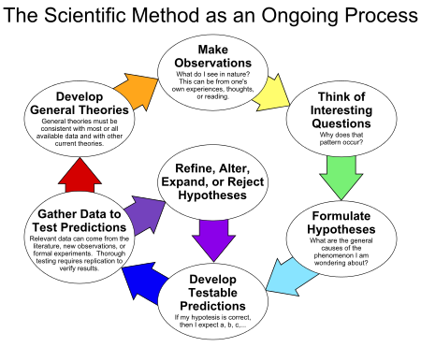
Model Selection
An alternative framework for statistical hypothesis testing is to specify a set of statistical models, one for each candidate hypothesis, and then use model selection techniques to choose the most appropriate model.
The most common selection techniques are based on either Akaike information criterion or Bayes factor.
Statistical hypothesis testing is sometimes called confirmatory data analysis. It can be contrasted with exploratory data analysis, which may not have pre-specified hypotheses.

Slide 37
Let’s jump right in...
… with model building and selection, using a Bayesian approach. First, we’ll need some background...

Slide 38
Useful Aside: Bayes’ Theorem
Bayes’ theorem tells us the relationship between the probability of observing a certain outcome, given some information is true, and the probability that the information is true, given we have observed the outcome:
P(H | E) = [P(E | H) /P(E)] P(H)
P(H | E) = [P(E | H) /[P(E | H) P(H) + P(E | ~H) P(~H)]] P(H)
Where H is hypothesis, and E is an event.
E.g. Going back to our coin flip example, say we flip a coin 10 times and we observe the outcome:
H H T H T T H H H H
Question: How confident do we feel that this is a fair coin?

Slide 39
Bayesian Inference: Coin Flip Example
For a fair coin, the probability of getting Heads is p = ½.
So, we can formulate our question in a mathematical formula:
P(p ∈ (½-ε, ½+ε) | 3T and 7H) = ?
Using Bayes’ Theorem, we have an answer:
P(p ∈ (½-ε, ½+ε)| 3T and 7H) =
P(3T and 7H | p ∈ (½-ε, ½+ε))P(p ∈ (½-ε, ½+ε))/P(3T and 7H)
We can calculate all the quantities on the right hand side of the equation.

Slide 40
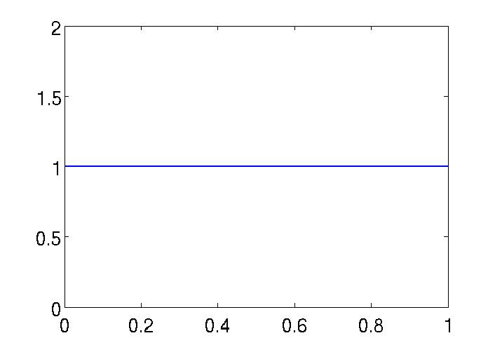
Bayesian Inference: Coin Flip Example
P(p ∈ (½-ε, ½+ε)| 3T and 7H) =
P(3T and 7H | p ∈ (½-ε, ½+ε))⨯
P(p ∈ (½-ε, ½+ε))/P(3T and 7H)
Note: to compute right-hand side, we have to make an assumption about the distribution of p--here, we’ll assume that p values are uniformly distributed on [0,1] (“uninformed prior”).
p (Probability of “Heads”)

Slide 41
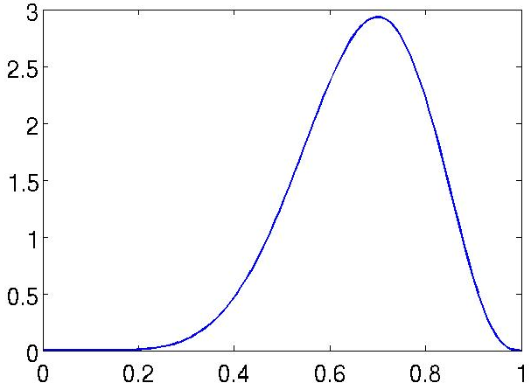
Bayesian Inference: Coin Flip Example
Result:
P(p ∈ (½-ε, ½+ε)| 3T and 7H) =
1.2891ε
This may not seem very helpful.
But, instead of using p = ½, we could plug in an arbitrary p value. Doing the calculation for all p in [0,1], we find the a posteriori distribution (probability density function) of p.
p (Probability of “Heads”)

Slide 42
Bayesian Inference: Coin Flip Example
Result:
P(p ∈ (½-ε, ½+ε)| 3T and 7H) =
1.2891ε
This may not seem very helpful.
But, instead of using p = ½, we could plug in an arbitrary p value. Doing the calculation for all p in [0,1], we find the a posteriori distribution (probability density function) of p.
Now we can use this as a prior for the next set of observations!
p (Probability of “Heads”)

Slide 43
Recap: Coin Flip
Note what we’re doing here…
We started with a parametric model for the coin flip experiment (in this case, the model is: “the coin lands Heads with with probability p”, where p is a parameter).
We treated p as a random variable (because we don’t know its value) and used the observed data to refine our knowledge of its distribution. -- That is, we’re building a model for the coin flip example!
But how do we know we picked the right model structure to begin with? Say we have two competing candidate models, and we want to know which is more likely to be correct...

Slide 44
Model Selection with Bayes’ Theorem
We can use Bayes’ Theorem to select a more likely model (eg. between Model 1 and Model 2), given a set of observations (Obs).
Bayes’ Theorem:
P(Model 1|Obs) = P(Obs|Model 1)P(Model 1)/P(Obs)
A priori, we don’t know which model is more likely… so say P(Model 1) = P(Model 2). Then, with a bit of algebra, we can get:
P(Model 1|Obs)/P(Model 2|Obs) = P(Obs|Model 1)/P(Obs|Model 2)

Slide 45
Bayes Factor
P(Model 1|Obs)/P(Model 2|Obs) = P(Obs|Model 1)/P(Obs|Model 2)
Bayes Factor is defined as:
K = P(Obs|Model 1)/P(Obs|Model 2)
If K is close to 1, the data does not distinguish between the two models;
If K is much smaller than 1, observations support Model 2;
If K is much larger than 1, observations support Model 1.

Slide 46
Another approach to Model Building
Another approach to model building is to use an estimator to select a value for the model parameters…

Slide 47
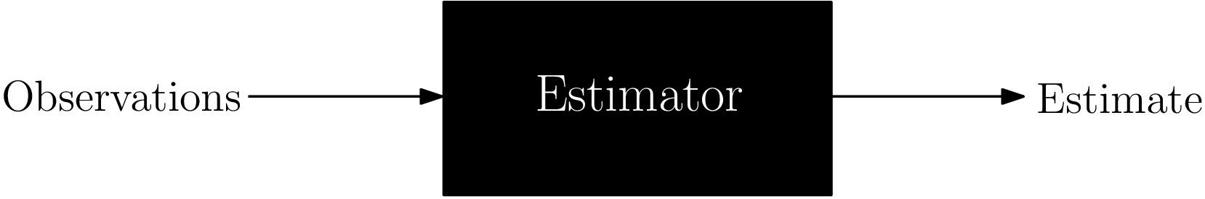
Estimator
An estimator is a rule that uses observations to give us an estimate of a given quantity.
Point estimator: outputs a single value (eg. a mean parameter value).
Interval estimator: outputs a range of plausible values (eg. quantiles).

Slide 48
Maximum Likelihood Estimate (MLE)
Suppose we want to estimate a parameter θ, given a set of observations. We’ll call the estimate “θ˄”.
We choose θ˄ that maximizes the posterior distribution of parameter values, given the observations (remember the Bayesian approach!).
Coin flip example
MLE estimate of p is 0.7
0.7
p (Probability of “Heads”)

Slide 49
MLE for Normal Variables
Assuming that the observed variables are normally distributed, the MLE estimates of the mean and variance are just the sample mean and sample variance.
mean = (X₁ + X₂ + … + X_{N})/N
variance = ((X₁- mean)²+ … + (X_{N}- mean)²)/N
Note: the MLE estimate for variance in this case is biased (that is, the expected value of the estimate is not equal to the true value of the variance)!
Nevertheless, MLE estimates are frequently used in practice.

Slide 50
Regression Analysis
Commonly used for prediction and forecasting.
Estimates the conditional expectation of the outcome given the predictor variables, i.e. the average value of the dependent variable when the independent variables are fixed.
In restricted circumstances, regression analysis can be used to infer causal relationships between the independent and dependent variables. NOTE THOUGH: Correlation does not imply causation.
Regression analysis will be covered in detail in the next class!

Slide 51
DONE
This is the last slideeeeee

Slide 52
Regression diagnostics
Once a regression model has been constructed, it is important to confirm the goodness of fit of the model and the statistical significance of estimated parameters.
Commonly used checks of goodness of fit include measuring R-squared, the analysis of the pattern of residuals and hypothesis testing.
Statistical significance can be checked by an F-test of the overall fit, followed by t-tests of individual parameters.
Interpretations of these diagnostic tests rest heavily on the model assumptions.
The results of a t-test or F-test are sometimes more difficult to interpret if the model's assumptions are violated.
Example: If the error term does not follow a normal distribution, the estimated parameters will not follow normal distributions in small samples and will complicate inference.
With relatively large samples, a central limit theorem can be invoked such that hypothesis testing may proceed using asymptotic approximations.

Slide 53
Nonlinear regression
When the model function is not linear in the parameters, the sum of squares must be minimized by an iterative procedure.
This introduces many complications which are summarized in differences between linear and non-linear least squares.
R library: nlstools()
Example: Simple nonlinear least squares fitting in R:
http://www.walkingrandomly.com/

Slide 54
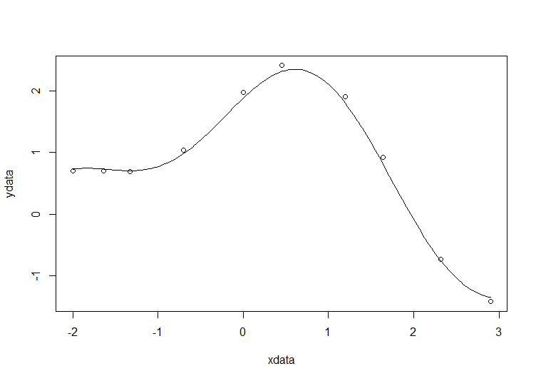
Nonlinear regression
Example:
xdata = c(-2, -1.64, -1.33, -0.7, 0, 0.45, 1.2 ,1.64, 2.32, 2.9)
ydata = c(0.699369, 0.700462, 0.695354, 1.03905, 1.97389, 2.41143, 1.91091, 0.919576, -0.730975, -1.42001)
plot(xdata,ydata)
# some starting values
p1 = 1
p2 = 0.2
# do the fit
fit = nls(ydata ~ p1*cos(p2*xdata) + p2*sin(p1*xdata), start = list(p1=p1,p2=p2))
summary(fit)
new = data.frame(xdata = seq(min(xdata), max(xdata), len=200))
lines(new$xdata,predict(fit,newdata=new))
sum(resid(fit)^2)
confint(fit)

Slide 55
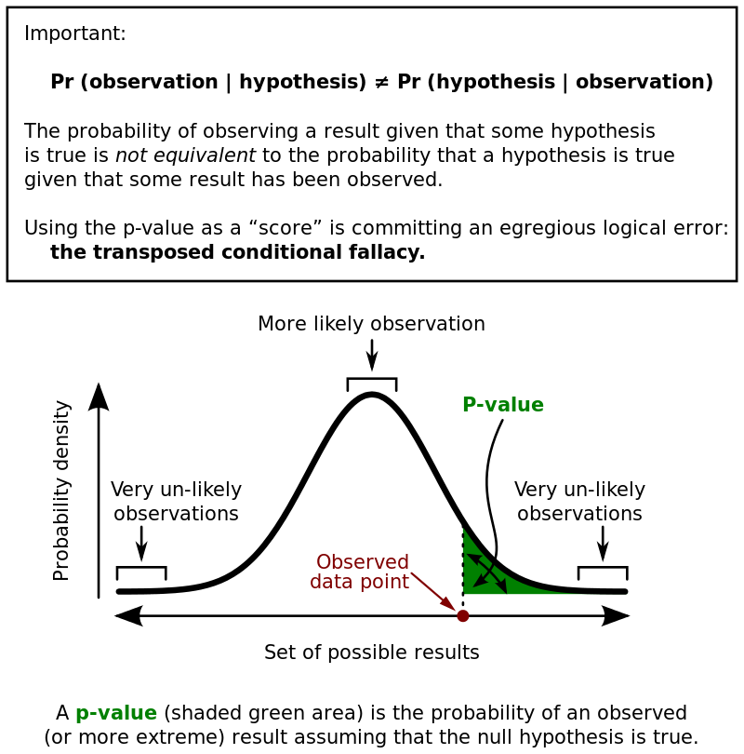

Slide 56
